Slide 1
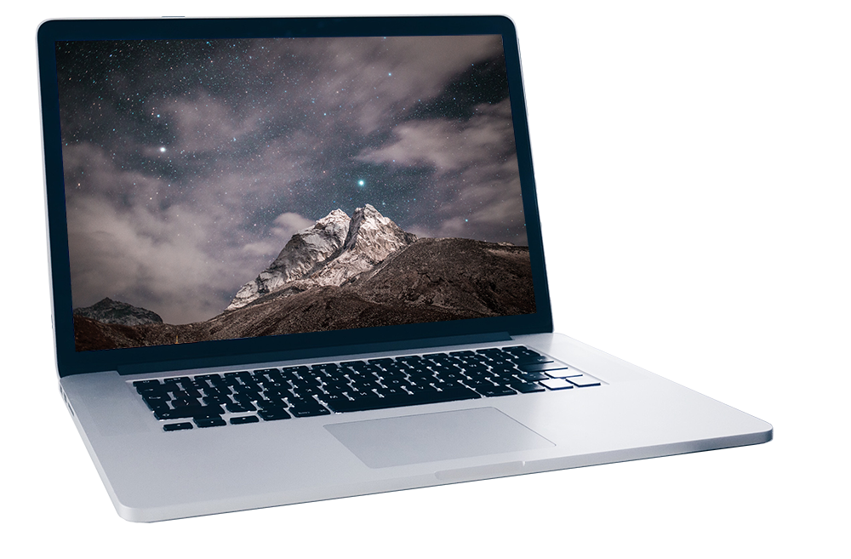
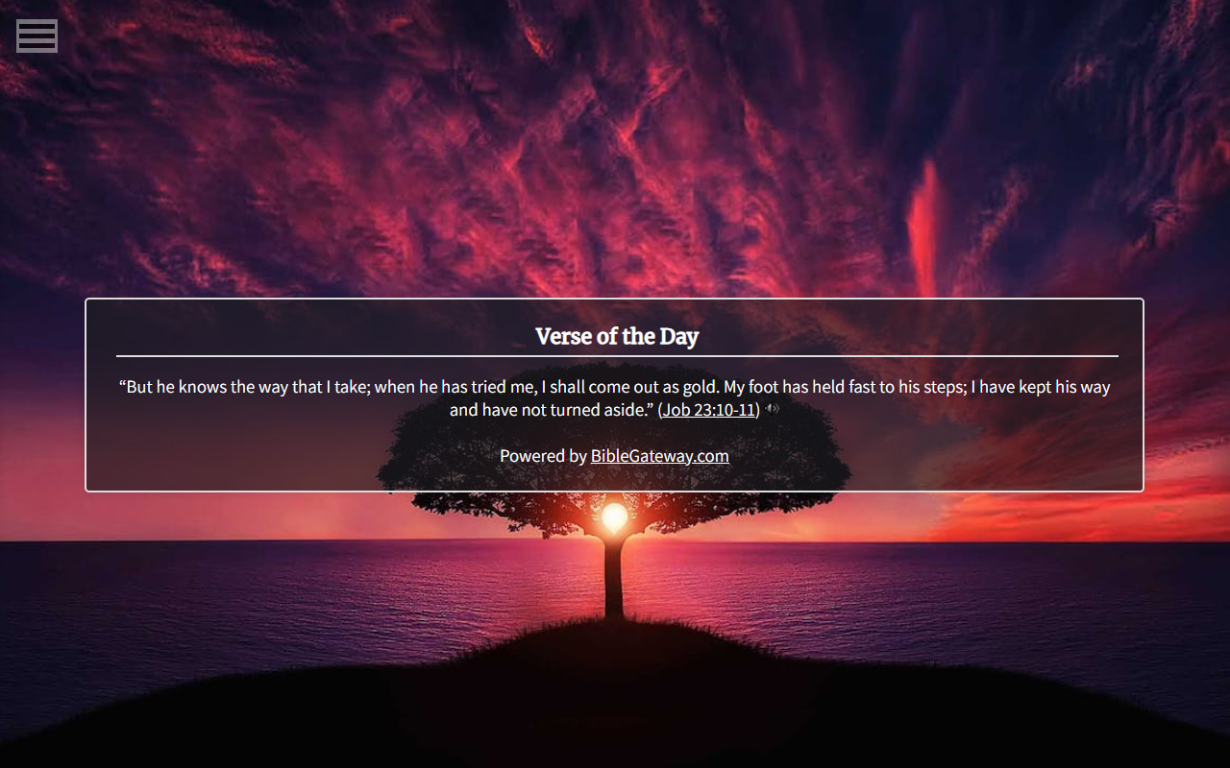

Bryce Furrow
B.S. Computer Science and Cybersecurity
Dr. Sean Hayes
Bible Verse Vista

Slide 2

Outdated
Generic backgrounds
Lack of Bible versions and languages
Lack of customization options
Problem

Slide 3
Google Chrome extension
Changes new tabs to have daily Bible verses
For all Christians browsing online
Easy to understand and operate
Highly customizable
Utilizes BibleGateway.com
Solution:
Bible Verse Vista

Slide 4
Demonstration…

Slide 5
Large selection of Bible versions (5)
Large selection of Bible languages (19)
Accurate Bible verses (22)
Save and reload settings (30)
Return to default settings (29)
Easy to understand and operate (12) …
Important Requirements

Slide 6
User Acceptance Testing (UAT)
10 formal testers
General and specific aspects
All answers with explanations
Testing Setup

Slide 7
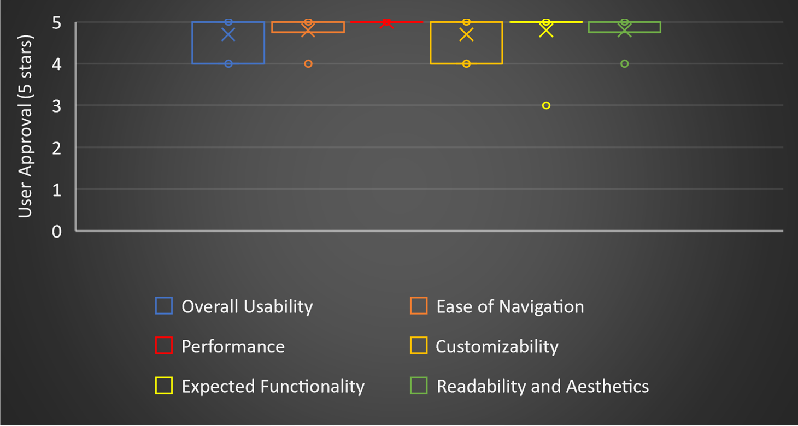
Test Results

Slide 8
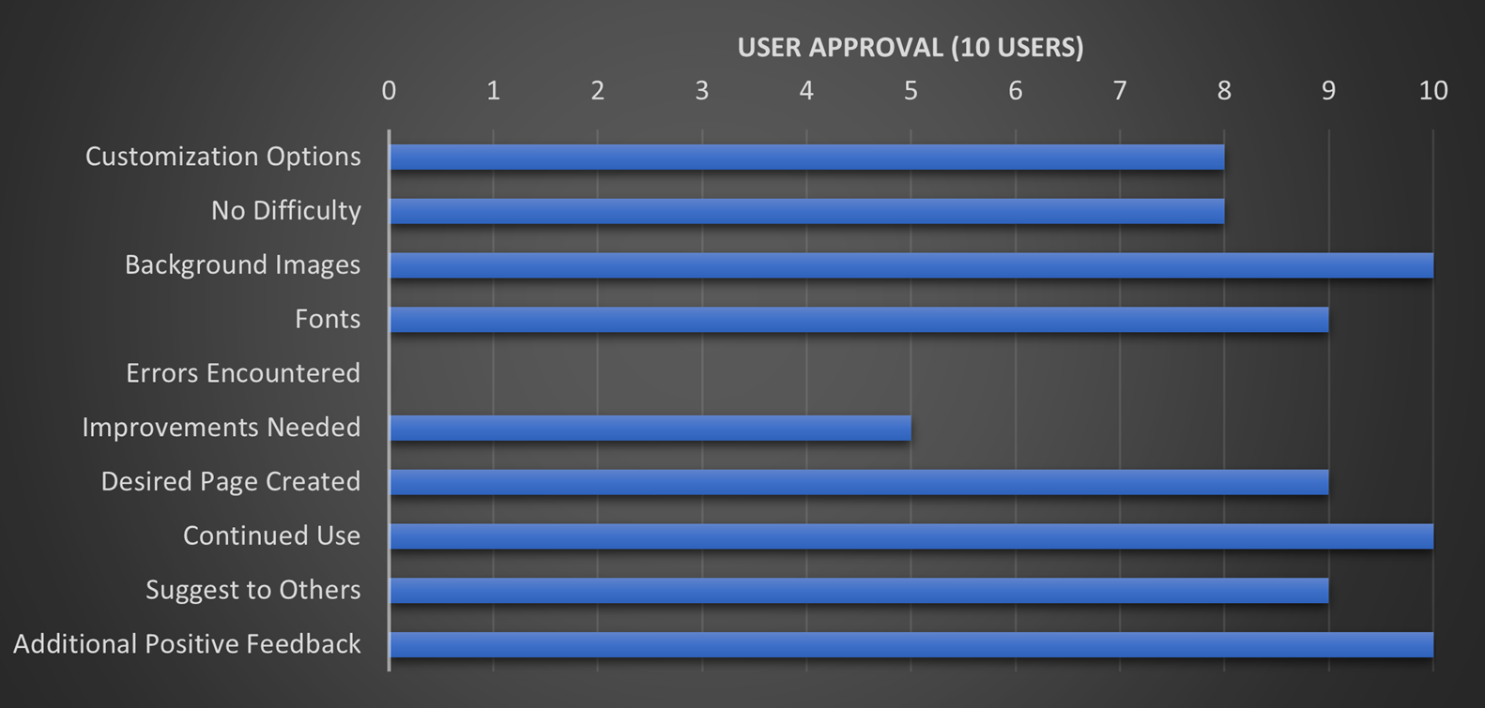
Test Results

Slide 9
Ongoing courses
Early creative planning
JavaScript (asynchronous especially)
Lost laptop workspace
API quota error
Testers and testing times
Chrome Web Store submission…
Challenges Overcome

Slide 10
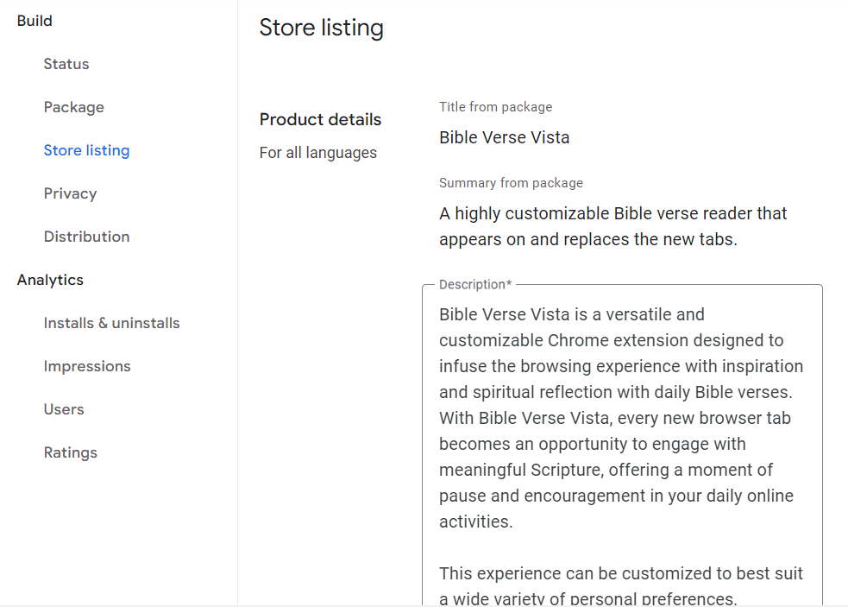
Store listing details, assets, and distribution
Extension purpose and functions
User data collection and/or use
Permissions justification
Chrome Web Store Submission

Slide 11
User-uploaded background images
Google widgets
Randomized Verse of the Day
Cursive fonts
Font previews
Randomized background images
(and more…)
Plans for the Future

Slide 12
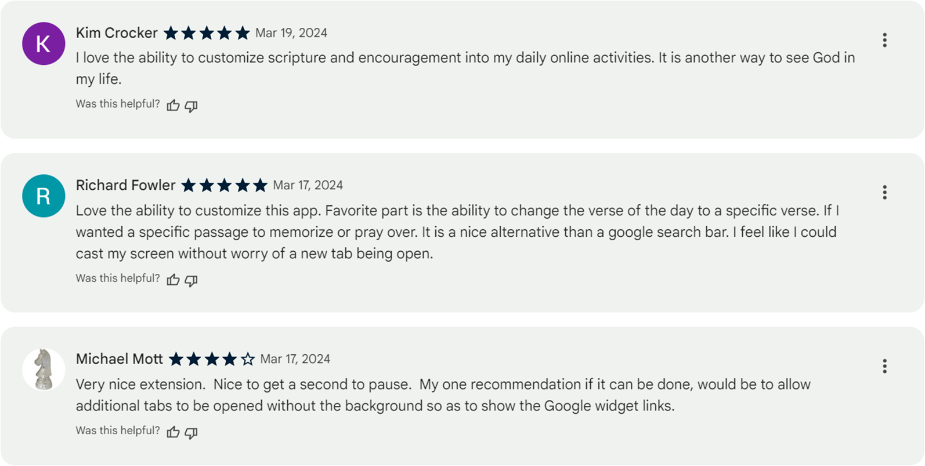
Overall Success

Slide 13
